Slide 1

The VisualHarness system:
Extending InfoHarness with Zebra image access system
Srilekha Mudumbai, Kshitij Shah, Amit Sheth, Krishnan
Large Scale Distributed Information Systems Lab
Department of Computer Science
University of Georgia
http://lsdis.cs.uga.edu/infoharneess
This work is part of the Bellcore-LSDIS/UGA project InfoHarness Phase II: A System for Scalable Search of Heterogeneous Information, Contract #: 96-F153200-000
supported by the Massive Digital Data Systems Program.
Notes:
1

Slide 2
Zebra: a system for customiZable and Extensible metadata-Based approach for accessing fedeRated imAge repositories
VisualHarness
InfoHarness
Zebra
Zebra is a logically independent component but uses
the InfoHarness platform for metadata management
and other capabilities.

Slide 3

Overview
Hey!
Challenge of dealing with increasingly broader range and
quantity of distributed digital media repositories, incl. images
Approach
  Customizable: Variety of access strategies with user:
  keyword-based, attributed based, content based (incl. visual)
  Extensible: New metadata can be extracted and
  corresponding access can be easily supported;
  support for and use of content independent, content descriptive
  and content based metadata,
  use of VIR engine as a Black box approach
  Federated: distributed and autonomous data repositories
  (integrated without restructuring, reformating, relocating)
Implemented, evaluation in progress
Notes:
2

Slide 4
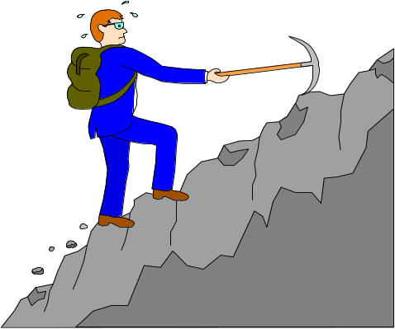
Goal : To get the high quality retrievals using a customizable, extensible, and iterative approach
Variety of metadata for different media (text, image,
structured data, video, etc.) and domains (photographic
images, satellite images, ...), and to access distributed
and heterogeneous data (different formats/representations)
Use of multiple access methods, including third party tools
for indexing, feature extraction, etc.
Combine different access methods for accessing
distributed repositories.
Zebra currently deals with images and associated texts
Notes:
8

Slide 5

Metadata Classification
Content-independent metadata
Content-dependent metadata
Content-based metadata
Content-descriptive metadata

Slide 6
requires -
processing
raw data
uses semantic
(domain-specific)
knowledge
Metadata
classification
Typical
Format
Examples from
image data
Content-
independent
attribute values
height, width, size,
date of creation etc.
No
No
Content-
dependent
Yes
No
feature vectors
or
attribute values
color, composition,
texture, structure etc.
Content-
based
No
Yes
color, height, fragrance, hybridizer
of a flower; model , category etc. of
an aircraft.
attribute values
Content-
descriptive
May be
Either
text and/or
keywords
Descriptions of a flower, an x-ray,
an air-craft (domain-specific);
General descriptions related to
the image (domain-independent)

Slide 7
Image Based
Access Component
(IBAC)
User Query
Results
Color
Composition
Texture
Structure
..
(extensible)
Attribute Access
Component
(AAC)
Height
Width
Size
Name
..
(extensible depending on the application)
User
Weights
Keyword Access
Component
(KAC)
Keyword
Three Component Model
Notes:
9

Slide 8
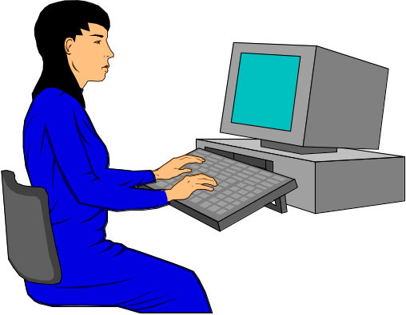
IH Server
IH Server
End User
Web
Browsers
IH Server
End User
Web
Browsers
Internet
End User
Web
Browsers
IH
administrative
tools
IH Clients
Repository
1
.....
Repository
m
Metadata Database (Metabase)
Raw Data
(Oracle)
Image
Audio
VisualHarness Architecture
Text
Video
Information Resources

Slide 9
Acess to Distributed Repositories
Distributed/local data repositories
in different domains
Infoharness
server
Satellite
Images
(NASA)
Aircraft
Images
(NASA)
CAD/CAM
Images
(Boeing)
Register
Medical
Images
(NJC)
Clip Art Images
(UGA)
Metabase (local)
Metabase (local)
Satellite
Aircraft
Medical
Clip Art
……..
CAD/CAM
….
….

Slide 10
Metadata Repositories
Distributed image
and text repositories
Index using WAIS,
LSI, Glimpse etc.
Query on
Keyword
Keyword based
Access
Repo 1
content-descriptive
(domain independent (or) domain dependent)
metadata
Keyword Component
Repo 2
Query on
extracted
metadata
Attribute based
Access
.
.
.
Media-specific
Extractors
content independent and content dependent
metadata
Attribute Component
Repo n
Extraction of image
properties with the
black-box approach
using Visual Information
Retrieval Engines
Query on
image
properties
Image based
Access
content dependent or content based metadata
Image Component
The Three Components
Notes:
10

Slide 11

Image(content)-based Access
How we
did it
Extraction of image features based on
Color (our own approach)
Texture (modified Wold Model from
MIT Media Labs)
Color, Composition, Texture, Structure (based
on Virage’s VIR, modified with black box approach)
Notes:
3

Slide 12




Image Properties - An understanding
Color characterized by hue and saturation.
Query ”Find all images in which more than 30% of the
pixels are sky blue and more than 25% of the pixels are
grass green (an outdoor picture)”
Composition
local color distribution
Query “Find all images with a blue patch in the center of the image and with a green patch around it”
Texture directionality, granularity and contrast
Query “Find all images that have similar pattern as the given image”
Structure computing color, area, elongation and centrality
for segmented regions
Query “Find all images containing two red circles close to
the center”
Gupta & Jain, COMMUNICATIONS OF THE ACM May 1997/Vol.40, No. 5

Slide 13
Black Box Approach of Computing Metadata from VIR
Metadata for combined access
Extractor
Color
Comp
Text
Struct
Attr’s
Image Data
color
composition
VIR
texture
structure
.
.
.
Null Image

Slide 14
Infoharness Object (IHO)
IH_OID
IH_Attr1
IH_Attr2
IH_Property1
IH_Property2
IH_Property3
IH_Name
IH_Index

Slide 15

Challenging Issues
Extraction of feature vectors (proprietary information)
Expensive computation during runtime
Search for good retrieval approaches to meet the above
challenging issues without knowing the internals of VIR
Notes:
4

Slide 16

How will I do it?
Black box approach
Distance metrics given by VIR
Mapping distance to different topological spaces
Similarity based on distance metrics
Null Image??
Notes:
5

Slide 17
Feature Space
O
1
query object
distance for feature F
Feature vectors
feature F
Null Image
e
O
n
Feature 1
comparision object
Feature vectors
feature F
Feature vectors of the object sequence in the database based on different properties of
an image is mapped to a point in the feature space; a query with tolerance e becomes a
sphere of radius e.

Slide 18
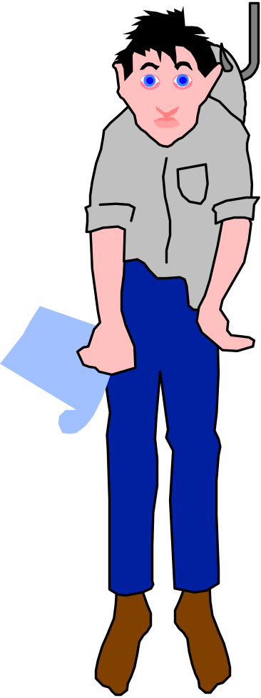
Comparison with typical VIR approach
Oh! NO
Sequential computation during runtime (time)
Possible memory overloading during runtime (space)
Notes:
6

Slide 19

Overcoming Runtime issues through
Extractors and DBMS
Precompute metadata (the distance metrics for properties)
Effective metadata management through DBMS
(metadata storage, query is posed on metadata)
Other significant advantages
Data can be in different repositories (distribution)
Metadata can be correlated (independent of media)
Notes:
7

Slide 20







Null Image
Classifier
Extractor
Image Feature
Extractor
Attribute
Extractor
Attribute
Classifier
Keyword
Extractor
Image
Classifier
Notes:
11

Slide 21


VisualHarness System
user query
with weights
Query Processing
Unit
Components
Distributed image and
text repositories
Results
InfoHarness
Server
Keyword-based
Search
Img Repo 1
Query
Engine
Attribute-based
Search
Img Repo 2
.
.
.
.
Image-based
Search
Normalize,
scale
the query
results
Img Repo n
VIR
Black box
approach
Three Component Architecture
Notes:
12

Slide 22

Query
Engine
User Query with weights
Keyword based search
Image based search
(WAIS, LSI, Glimpse etc.)
Attribute based search
(color,composition,
texture, structure etc.)
(height, width, size etc.)
Query
Hits
Query
Hits
scale for given
property weights
Normalize
Query
Normalize
Normalize
Hits
Scale
Scale
Scale
Combine Results
Final Normalization
Query Processing Unit
Notes:
13

Slide 23

Constraints
Weights
How to combine?
keyword
x
a
Attribute
y
b
user specified
constraints
Full Query:
Image
z
c
ax+by+cz
Attribute weight b = 1.0
{
Image size
Format
Date of creation
content-independent
Attribute
{
content-dependent (or)
content-based
Main RGB
Main color
y
Keyword weight a
x
z
{
(z1)
(z2)
(z3)
(z4)
xyz
color composition
texture
shape
content-descriptive
Keyword
Image
content-dependent
keyword query using
third party indexing technologies
Ranking assigned by indexing technique
Image weight c
Property weights i1, i2, i3 and i4
z = i1z1 + i2z2 + i3z3 + i4z4
customizable and extensible metadata-based approach
Notes:
14

Slide 24
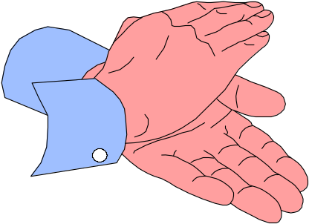
Visual Information Retrieval
Vs
Black box approach
VIR
Black box
Comparison
Finds out acute differences
between images
Somewhat less accurate. For example,
distance remains the same between
null image and input images if they
have slight difference in their color.
The challenging issue to find out a
good null image and a good strategy
so as to get the retrievals comparable
to the VIRs.
If two similar images but of
different size are considered,
VIR finds a huge difference.
Size should not make a difference
if mapping to feature vector space
is considered.
With black box, any image compared
against a null image retains its property
distance metrics irrespective of the size
of the null image.
Notes:
15

Slide 25


Identical Images (id1) & (id2) and Null Image (N)
id2
id1
Structure difference
d1
d1 = 29.394659
d2 = 48.719234
d3 = 52.613445
id1
N
d2
d1 > (d3 - d2)
id2
N
d3

Slide 26
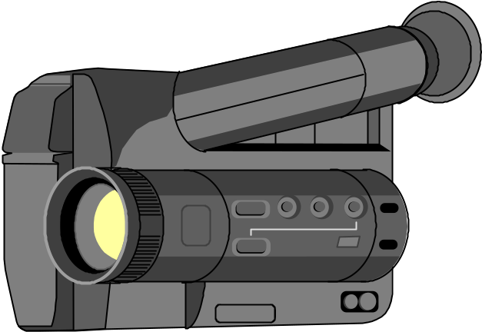
Related Work
Content-based retrieval
  Virage (VIR)
  The Media Laboratory (Photobook)
  QBIC (Query By Image Content
Metadata-based approach
  Content-based retrieval using metadata and relaxation techniques.
Web-based access
  Search engines (altavista, excite, electric library etc.)

Slide 27

Conclusions and Future work
Comprehensive search involving keyword, attribute and
content-based access; user can customize wrt to different
access methods and iteratively refine the query.
Subjectively results look promising in several cases; quantitative
comparison is being completed.
Advantage of database-based metadata management include:
use of third party VIR engines, use of database query processing for complex search, metadata correlation, data distribution.
Prior work was limited to textual data; work with structured database has started; in future video and audio data will be supported.
Future work:
  build a more interactive graphical user interface
  find out a good null image
  support for other forms of multimedia such as audio, video etc.

Slide 28
Demo
For demonstration and further information
contact Prof. Sheth at amit@cs.uga.edu

